Slide 1


Power System Optimization & Battery Simulation
Chief Supervisors: Prof. Siqi Bu & Prof. C. Y. Chung (FIEEE )
Co-Supervisor: Prof. Dipti Srinivasan (FIEEE )
The Hong Kong Polytechnic University
QS Rank 57th in the world

Slide 2
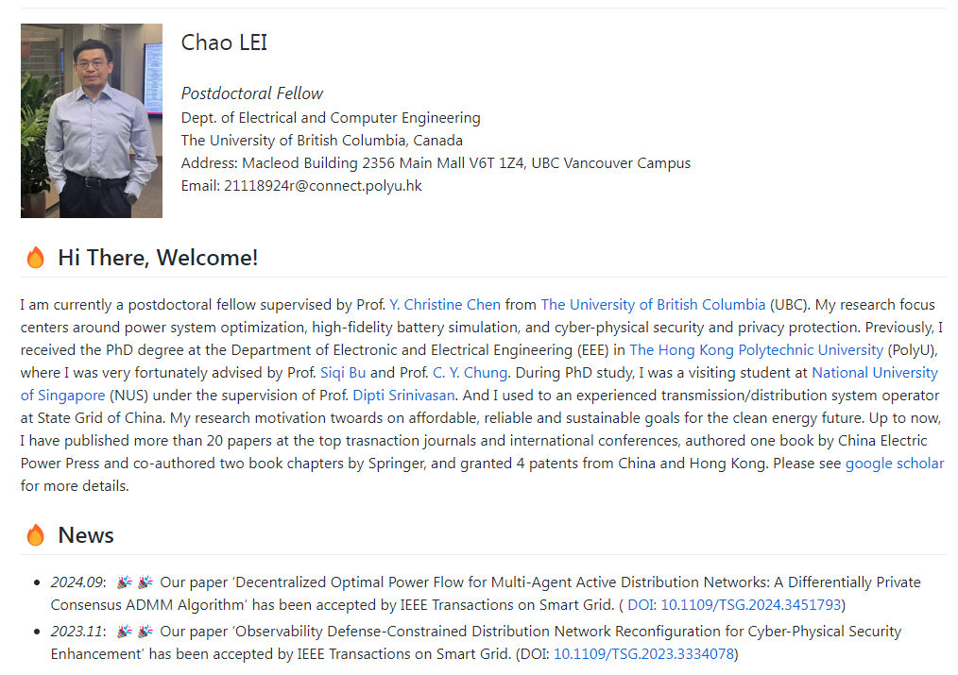



Personal Homepage - https://honolulufishing.github.io/Homepage
QS 34th in the world
QS 8th in the world
QS 57th in the world

Slide 3
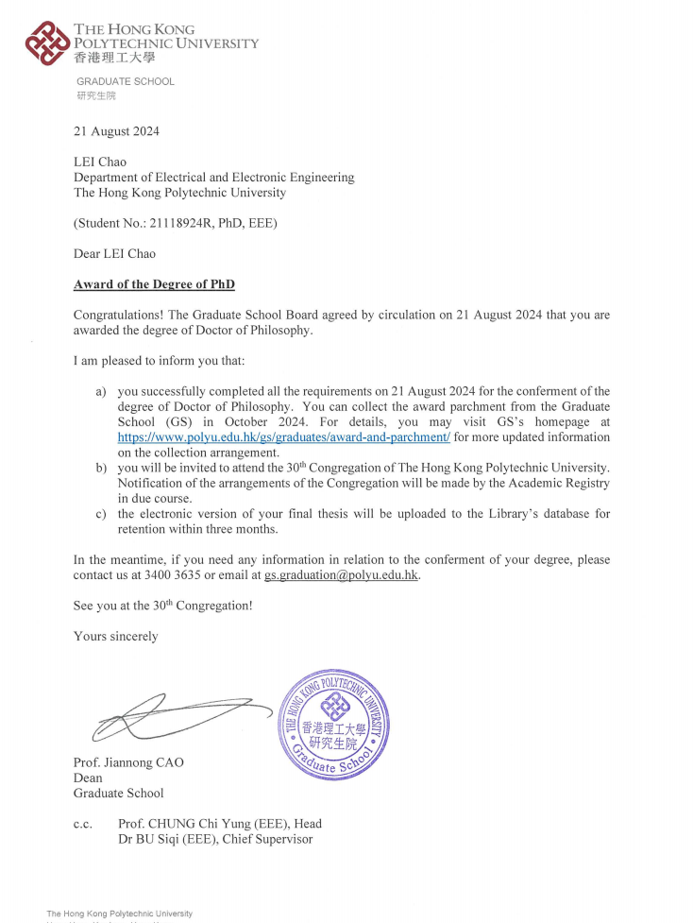
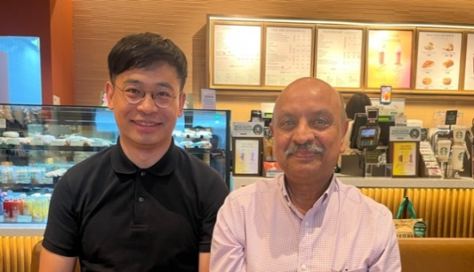
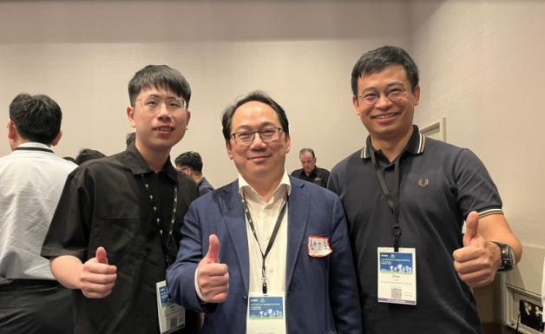
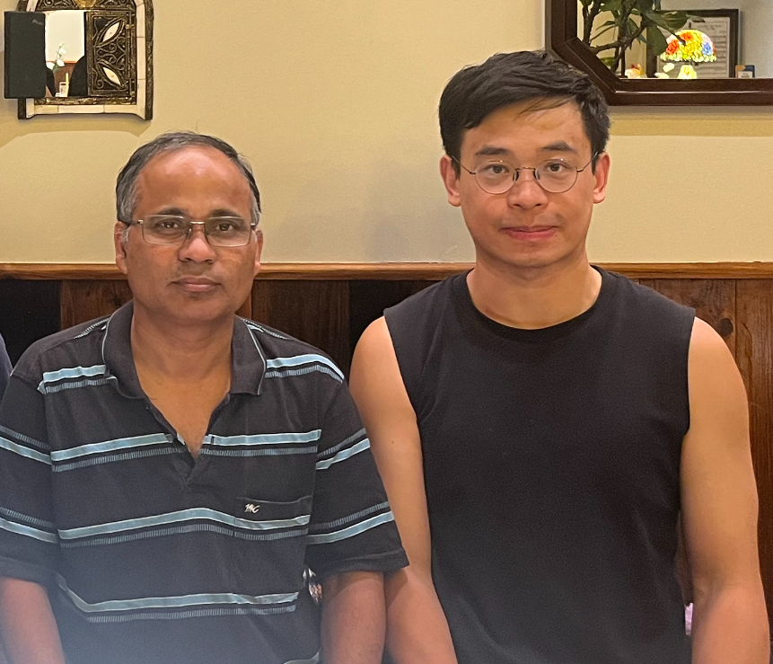
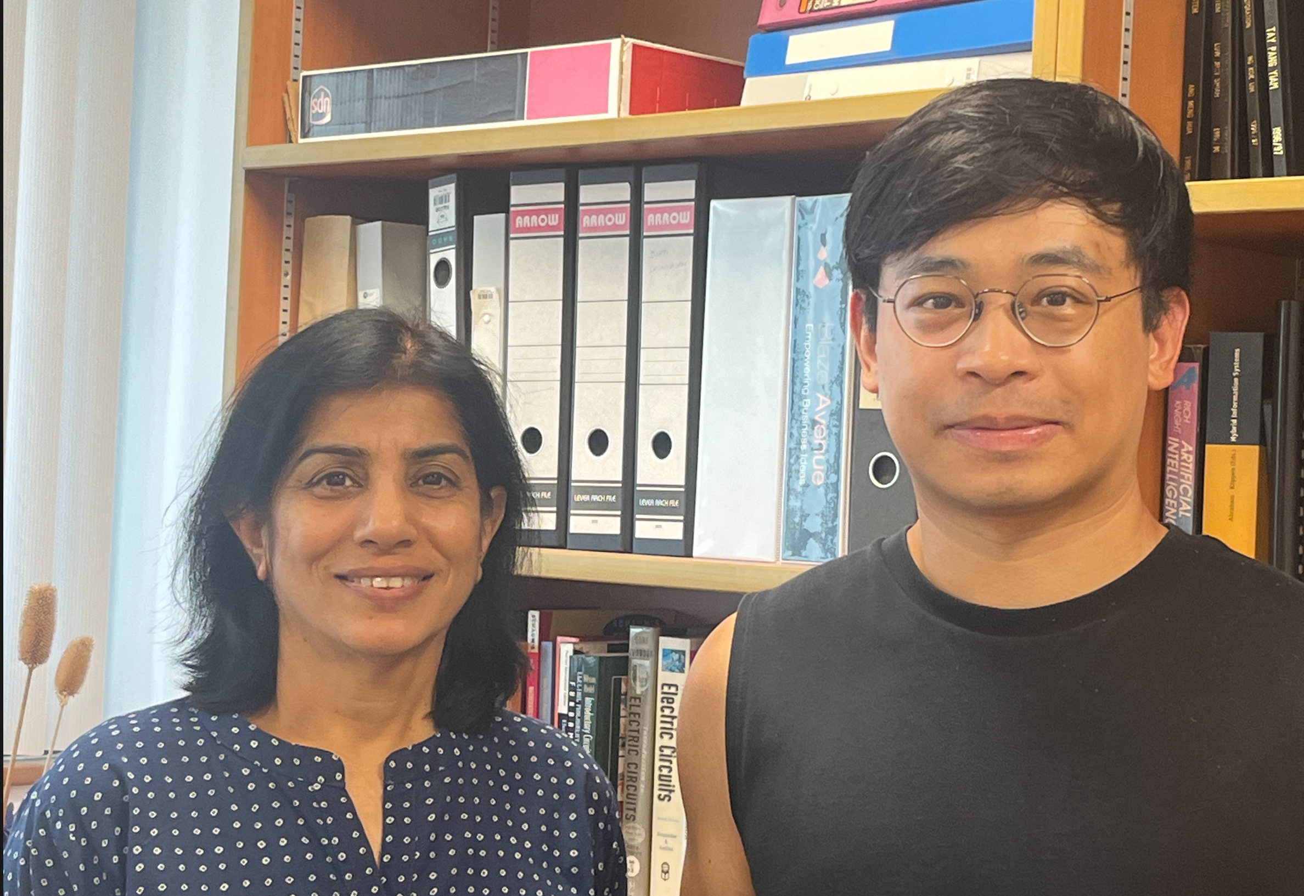
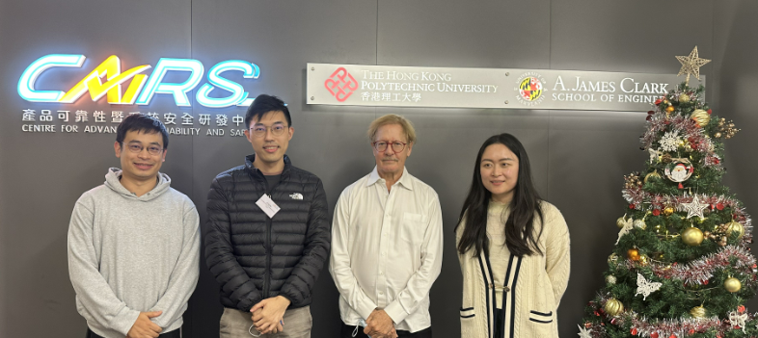
Academic Network
Prof. Lalit GOEL, FIEEE (NTU)
Prof. CY Chung, FIEEE (PolyU)
Prof. Bikash Pal, FIEEE (Imperial)
Prof. Dipti Srinivasan, FIEEE (NUS)
Prof. S. Q. Bu (PolyU) and Prof. Michael Pecht, FIEEE (UM)

Slide 4
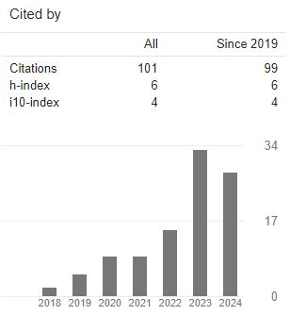
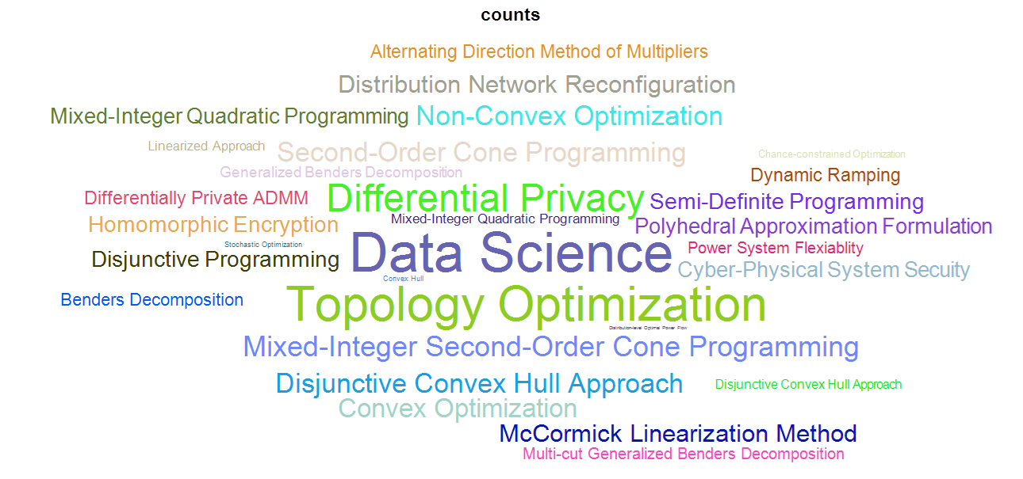
Research Outputs During PhD Study – Overview
International Journal
14 journal papers including published and under review
5 IEEE Transactions with first authorship
5 papers have been submitted to IEEE Trans. Power Syst.
Conference proceeding
1 conference paper
Granted Patent
1 granted patent
Book & Book Chapters
1 book and 2 book chapters all with first authorship
Part A: Topology Switch and Retrofitted Resources for Grid Operational Flexibility Enhancement
Part B: Battery Aggregation for Grid Operational Flexibility Enhancement
Part C: Cyber-Physical Security, Privacy Guarantee and Stability

Slide 5
Research Outputs During PhD Study
Part A: Topology Switch and Retrofitted Sources for Grid Operational Flexibility Enhancement
1. C. Lei, S. Bu, Q. Wang, Q. Chen, L. Yang, and Y. Chi, "Look-ahead Rolling Economic Dispatch Approach for Wind-Thermal-Bundled Power System Considering Dynamic Ramping and Flexible Load Transfer Strategy," IEEE Transactions on Power Systems, vol. 39, no. 1, pp. 186-202, Jan. 2024.
2. C. Lei, S. Bu, J. Zhong, Q. Chen and Q. Wang, “Distribution Network Reconfiguration: A Disjunctive Convex Hull Approach,” IEEE Transactions on Power Systems, vol. 38, no. 6, pp. 5926-5929, Nov. 2023.
3. C. Lei, S. Bu, Q. Wang, N. Zhou, L. Yang, and X. Xiong, "Load transfer optimization considering hot-spot and top-oil temperature limits of transformers," IEEE Transactions on Power Delivery, vol. 37, no. 3, pp. 2194-2208, June 2022.
4. C. Lei, S. Bu and Q. Wang, "Load Transfer Optimization with Graph Characterizations on Different Time-Scales for Multi-Voltage Distribution Networks Against Overload Cascades," IEEE Transactions on Power Delivery, 2024 (Under Review).
5. C. Lei, Q. Wang, G. Zhou, S. Bu, N. Zhou, T. Lin and W. Fang, "Probabilistic wind power expansion planning of bundled wind-thermal generation system with retrofitted coal-fired plants using load transfer optimization," International Journal of Electrical Power & Energy Systems, vol. 151, 2023
6. Y. Zou, Q. Wang, Y. Chi, J. Wang, C. Lei and N. Zhou, "Electric Load Profile of 5G Base Station in Distribution Systems Based on Data Flow Analysis," IEEE Transactions on Smart Grid, vol. 13, no. 3, pp. 2452-2466, Feb 2022.
7. Y. Zou, Q. Wang, Q. Xia, Y. Chi, C. Lei, N. Zhou, " Federated reinforcement learning for Short-Time scale operation of Wind-Solar-Thermal power network with nonconvex models," International Journal of Electrical Power & Energy Systems, vol. 158, 2024.
8. Q. Wang, J. Wang, C. Lei and N. Zhou, "Short-term planning model for distribution network restructuring based on heat maps," IET Generation, Transmission & Distribution, vol. 12, no. 14, pp.3569-3577, 2018.
9. Q. Wang, J. Liao, Y. Su, C. Lei, T. Wang and N. Zhou, "An optimal reactive power control method for distribution network with soft normally-open points and controlled air-conditioning loads," International Journal of Electrical Power & Energy Systems, vol. 103, 2018
10. S. Yu, N. Zhou, Q. Wang, C. Lei and J. Fang, "Optimal Planning Method of On-load Capacity Regulating Distribution Transformers in Urban Distribution Networks after Electric Energy Replacement Considering Uncertainties," Energies, vol. 11, no. 6, pp.1457, 2018

Slide 6
Research Outputs During PhD Study
Part B: Battery Aggregation for Grid Operational Flexibility Enhancement
11. C. Lei, S. Bu, Q. Wang, Z. Ren and D. Srinivasan, "Battery Dispatch Optimization for Electric Vehicle Aggregators: A Decomposition-Coordination-based Least Squares Approach with Disjunctive Cuts," IEEE Transactions on Power Systems, 2024 (Under Review).
12. C. Lei, S. Bu, Q. Wang and D. Srinivasan, "Aging-Aware Vehicle Battery Dispatch for Aggregators: A Digital-Twin-enabled Rolling Optimization Framework," IEEE Transactions on Power Systems, 2024 (Under Review).
Part C: Cyber-Physical Security, Privacy Guarantee and Stability
13. C. Lei, S. Bu, Q. Wang and L. Liang, "Observability Defense-Constrained Distribution Network Reconfiguration for Cyber-Physical Security Enhancement," IEEE Transactions on Smart Grid, vol. 15, no. 2, pp. 2379-2382, March 2024.
14. C. Lei, S. Bu, Q. Chen, Q. Wang and D. Srinivasan, "Decentralized Optimal Power Flow for Multi-Agent Active Distribution Networks: A Differentially Private Consensus ADMM Algorithm," IEEE Transactions on Smart Grid, 2024. (Early Access).
15. C. Lei, S. Bu, Q. Chen, Q. Wang and D. Srinivasan, "A Consensus ADMM-based Differentially Private Reconfiguration Approach for Multi-Agent Active Distribution Networks," IEEE Transactions on Power System, 2024 (Under Review).
16. H. Wang, F. Gao, S. Bu, C. Lei and Q. Chen, “Instability Pattern-guided Model Updating Method for Data-driven Transient Stability Assessment," IEEE Transactions on Power Systems, 2023 (Early Access)
17. Q. Chen, S. Bu, H. Wang and C. Lei, “Real-time Multi-stability Risk Assessment and Visualization of Power Systems: A Graph Neural Network-based Method," IEEE Transactions on Power Systems, 2024 (Early Access).
Part D: Granted Patents
1. S. Bu, G. Lu, E. Yim and C. Lei, "A Health Index System and Method of Predicting Health Condition in Underground Cables," HK30064886, 08/07/2023, Hong Kong.
Part E: Book & Book Chapters
1. C. Lei, Q. Wang and N. Zhou, "Load Transfer Optimization in Smart Distribution Networks," Publisher: China Electric Power Press, 2024.
2. C. Lei and Q. Wang, Two Book Chapters of Modelling and Optimization of Power and Energy Resources, edited by Farhad Shahnia and Fushuan Wen, Publisher: Springer Press, 2024.

Slide 7
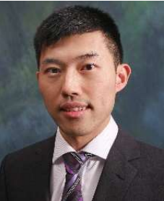
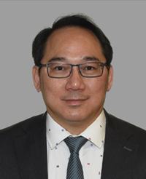
RISA Research Group Leader – Chief Supervisors
Prof. Siqi Bu (Steve)
Ph.D. degree, The Queen’s University of Belfast, Belfast, U.K.
National Grid UK as an experienced UK National Transmission System Planner and Operator.
Associate Professor and Associate Head with Department of Electrical and Electronic Engineering, The Hong Kong Polytechnic University.
Chartered Engineer with UK Royal Engineering Council, London, U.K.
Editors of IEEE Transactions on Power Systems, IEEE Power Engineering Letters.
Prof. C. Y. Chung
President-Elect of IEEE PES Governing Board.
Head of Department and Chair Professor of Power System Engineering, The Hong Kong Polytechnic University.
Fellow of Canadian Academy of Engineering (CAE)
Fellow of The Institute of Electrical and Electronics Engineers (FIEEE)
Fellow of The Engineering Institute of Canada (EIC)
Consulting Editors of IEEE Transactions on Power Systems, IEEE Transactions on Sustainable Energy, IEEE Power Engineering Letters, etc.

Slide 8


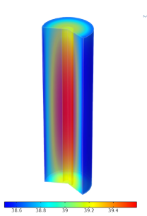
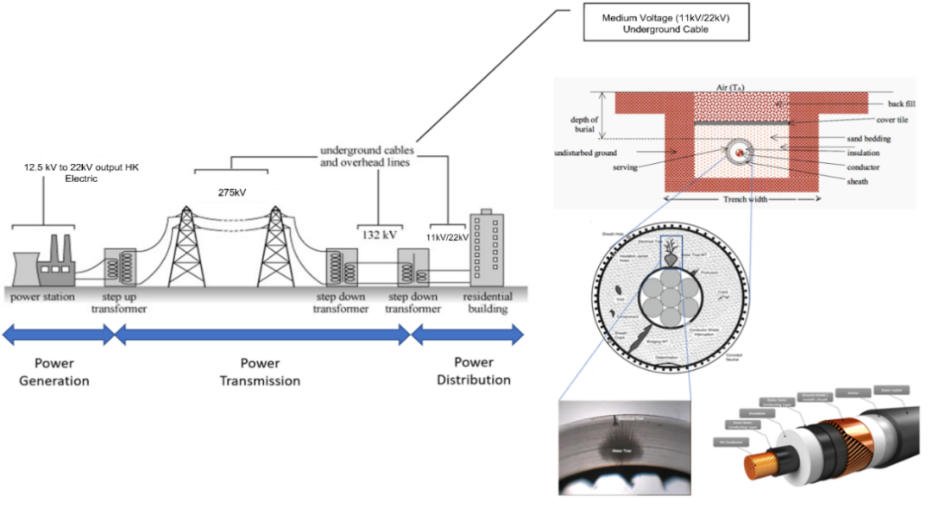
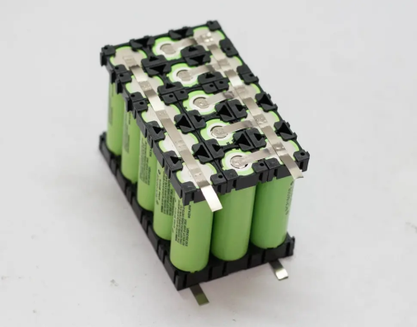
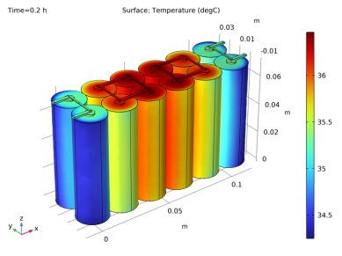
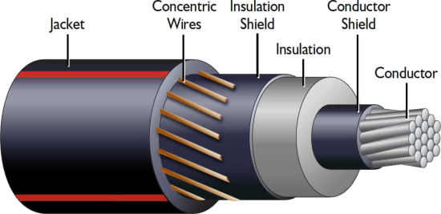
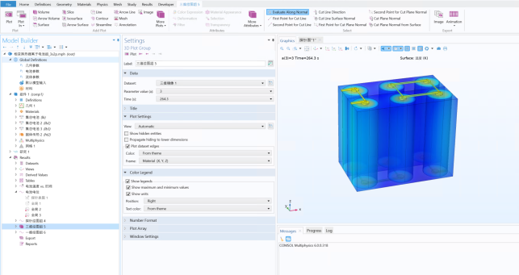
Centre for Advances in Reliability and Safety – PI
Prof. Michael Pecht
Distinguished University Professor, University of Maryland
Founder, Center for Advanced Life Cycle Engineering (CALCE)
Maryland Energy Innovation Institute
ASME Fellow and an SAE Fellow
Fellow of The Institute of Electrical and Electronics Engineers (FIEEE)
Editor-in-chief of IEEE Transactions on Reliability
Adaptive diagnostics of Water Tree in Medium Voltage Underground Cable using Transfer Learning and Simulation-based Analysis to Assess Cable Condition and Predict Remaining Useful Life (CAIRS in Hong Kong)
Underground XLPE (Cross-linked polyethylene) Cable
Life Span Prediction of
Battery Pack 18650

Slide 9
Part 1 Finite Element Analysis - COMSOL Simulation
App.1 – Electrochemical-Thermal Coupled Modeling
App.2 – Blade Lithium-Ion Battery for BYD Company
Expertise - COMSOL Simulation
Degraded Underground XLPE Cable
Electrochemical-Thermal Coupled Modeling
Electric Circuit Breaker - Arc Simulation
Life Cycle Prediction for Underground Cables¹
Reference: 1. S. Bu, G. Lu, E. Yim and C. Lei, “A Health Index System and Method of Predicting Health Condition in Underground Cables,” HK30064886, 08/07/2023, Hong Kong. (Winning the Golden Prize at 49th The International Exhibition of Inventions Geneva, Switzerland, 2024)

Slide 10
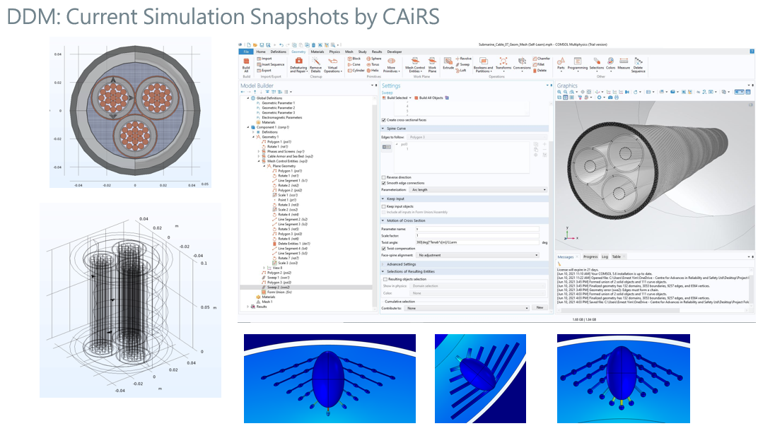

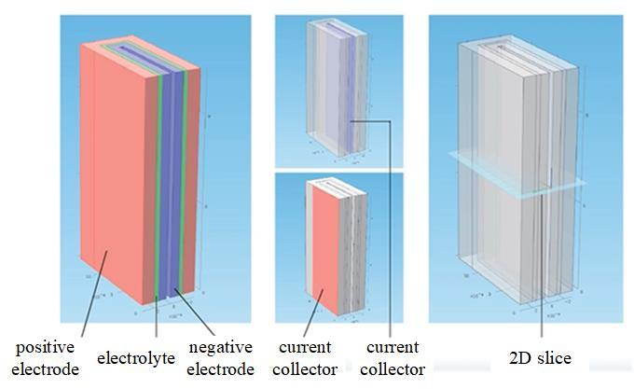
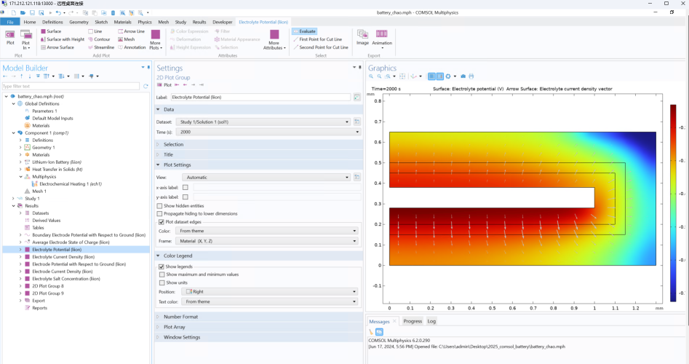
1 Finite Element Analysis - COMSOL Simulation
Overview of Multi-Physics Simulation
Fully coupled multi-physics and single-physics modeling capabilities
General-purpose simulation software based on advanced PDE methods.
Degraded Underground Cable
Electrochemical-thermal coupled model
Electric Circuit Breaker
Underground Cable: Water tree propagation for estimating the remaining useful life
Electrochemical-thermal coupled model: electrochemistry and heat transfer are coupled for parameter estimation
Circuit Breakers: Electric arc duration time for preventive maintenance scheduling

Slide 11

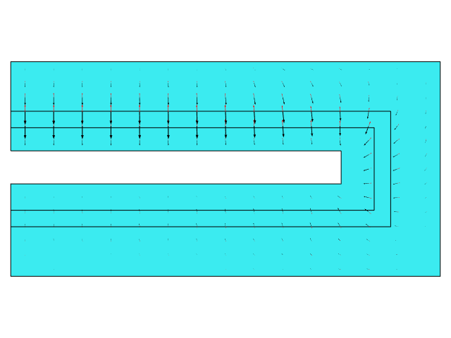
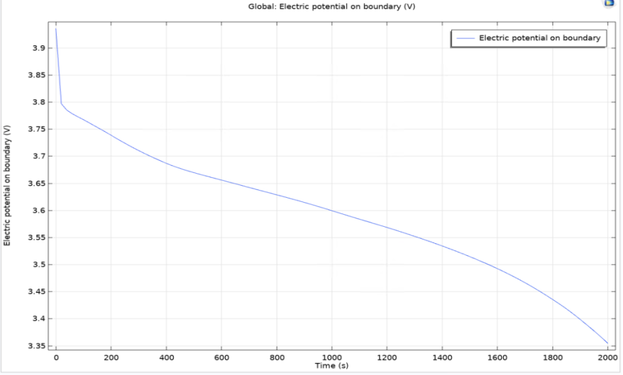
App.1 – Electrochemical-Thermal Coupled Modeling
Electrochemical Behavior when Discharging
Porous Electrode Negative – LixC6
Porous Electrode Positive - LiMn2o4
Electrolyte - LiPF6 in 1: 2
Nominal capacity of 0.08 Ah and nominal voltage of 3.9 V
Initial condition: SOC=0.8, positive electrode current at = -0.08 A
The initial concentration of lithium is in the positive electrode.
As lithium is dissolved on the negative lithium metal electrode, the concentration in the positive electrode increases.
Electrode Potential to ground
Electrolyte Salt Concentration
Power dissipation density (Heat)

Slide 12
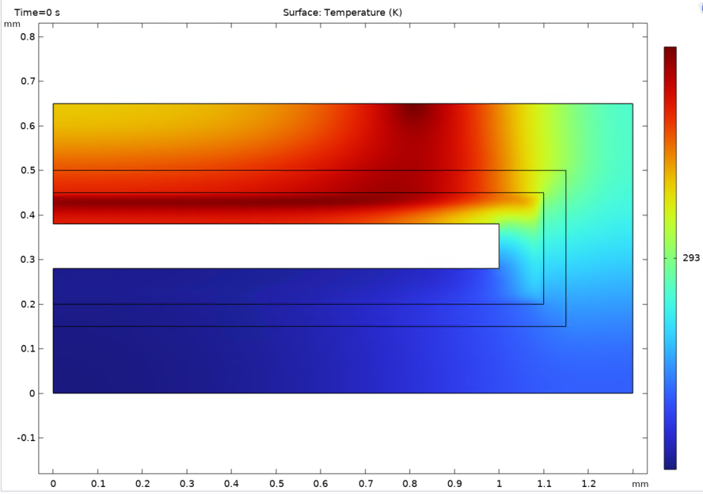
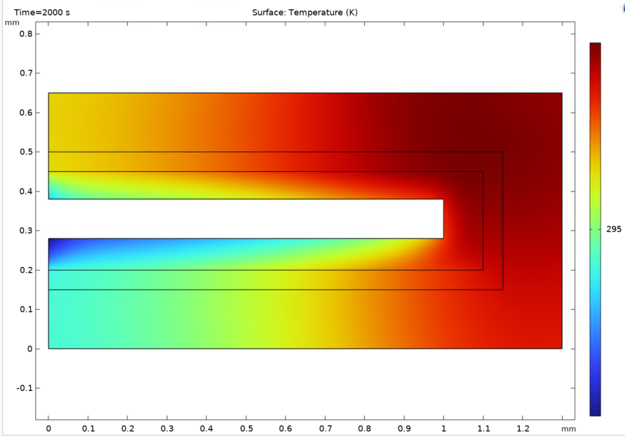
App.1 – Electrochemical-Thermal Coupled Modeling
Thermal Distribution Effect when Discharging
Power dissipation, irreversible heat, and reversible heat that may influence some parameters, i.e., diffusion coefficient for materials LixC6 (negative) and LiMn2o4 (positive)
Convective heat between a solid fluid (battery surface) and moving air
Heat transfer coefficient h=5
293K
295K
Thermal distribution at the beginning
Thermal distribution at the end

Slide 13
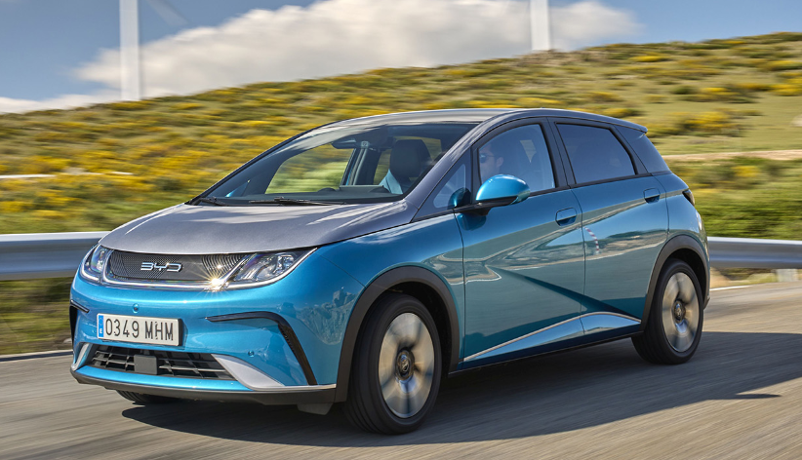
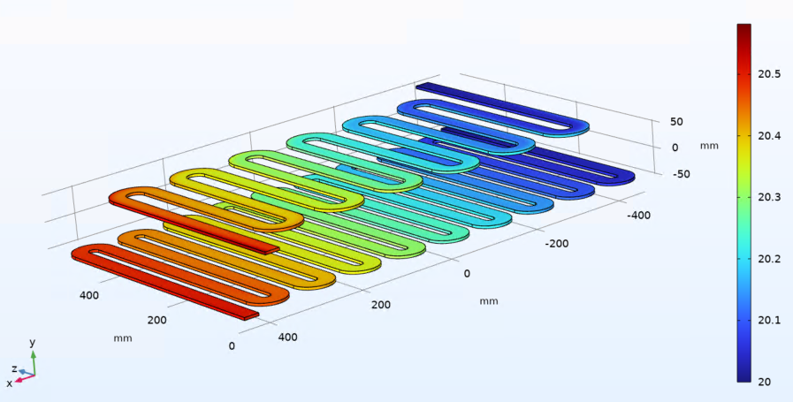
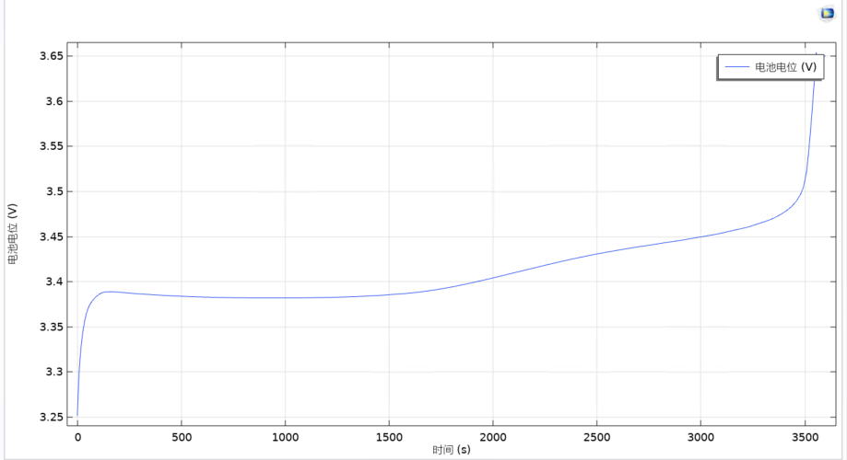
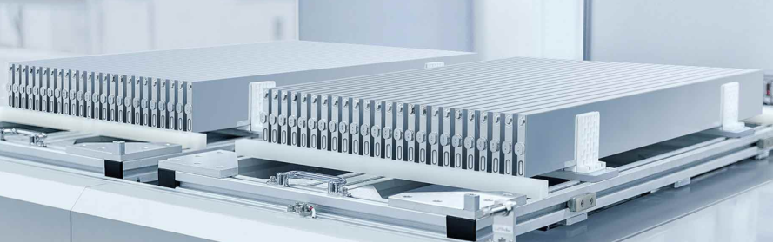
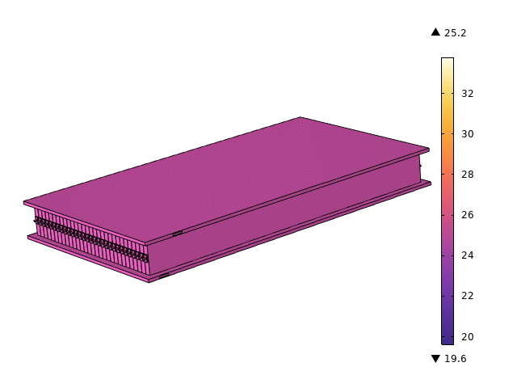
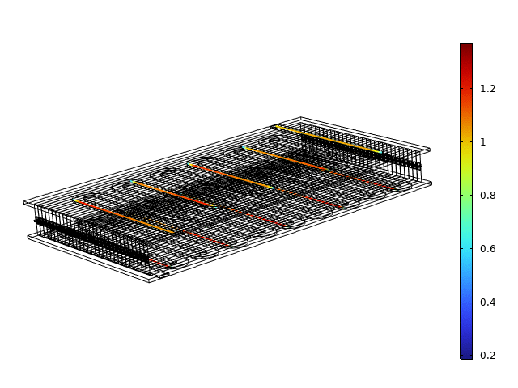
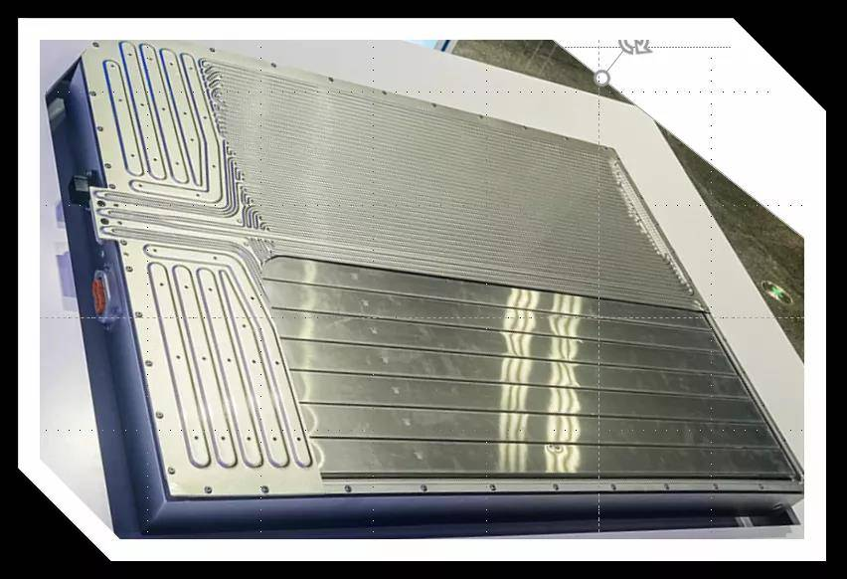
App.2 – Blade Lithium-Ion Battery for BYD Company
Electrochemical-Thermal Effect when charging
Electrochemical-Thermal Modeling
Turbulent thermal convection between a solid and a liquid (water motion)
Liquid-cooled battery cooling
Voltage Behavior
Thermal distribution
Convection distribution
Blade Battery for EV

Slide 14
2 Power System Optimization (PhD Focus)
App.3 Vehicle Battery Dispatch Optimization (EMS) for EV Aggregators
App.4 Observability Defense-Constrained Distribution Network Reconfiguration
App.5 Differentially Private ADMM Approach for Optimal Power Flow
Expertise - Optimization & Industrial Experience
Convex optimization: convex hull relaxation¹, disjunctive programming¹, mixed-integer programming
Decentralized computation: Benders decomposition², ADMM, Lagrangian relaxation³
Differentially private optimization: Gaussian mechanism, Laplace mechanism³
Data-driven optimization: DBSCAN, SVM, k-means
Reference 1. C. Lei, S. Bu, J. Zhong, Q. Chen and Q. Wang, "Distribution Network Reconfiguration: A Disjunctive Convex Hull Approach," IEEE Transactions on Power Systems, vol. 38, no. 6, pp. 5926-5929, Nov. 2023.
2. C. Lei, S. Bu, Q. Wang, Q. Chen, L. Yang and Y. Chi, "Look-Ahead Rolling Economic Dispatch Approach for Wind-Thermal-Bundled Power System Considering Dynamic Ramping and Flexible Load Transfer Strategy," IEEE Trans. on Power Systems, vol. 39, no. 1, pp. 186-202, Jan. 2024.
3. C. Lei, S. Bu, Q. Chen, Q. Wang and D. Srinivasan, “Decentralized Optimal Power Flow for Multi-Agent Active Distribution Networks: A Differentially Private Consensus ADMM Algorithm," IEEE Trans. on Smart Grid, 2024 (Early Access)

Slide 15
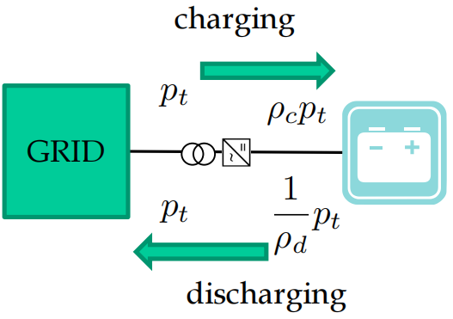
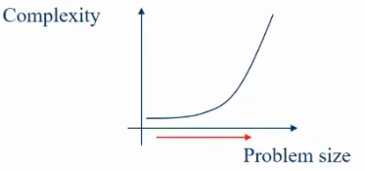
App.3 Battery Dispatch Opt. (EMS) for EV Aggregators
State of Energy (SoE) Equation – Mixed Integer Linear Programming (MILP) Form
- Charging and discharging indicator variables
- Charging and discharging power
- charging/discharging coefficients
- Energy at time t and period duration
Mathematical Property
If idle, ; otherwise, = (1,0) or (0,1)
complementary constraints, if only holds
and have to be binary variables; otherwise, complementary constraints cannot be held
Battery dispatch optimization is very computationally challenging!
SoE equations are mixed-integer formulation

Slide 16
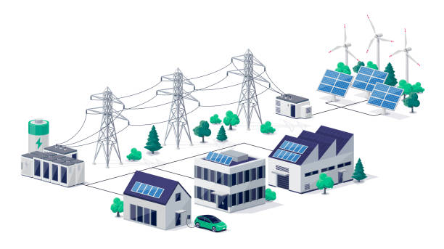



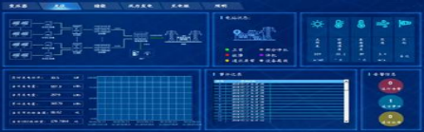


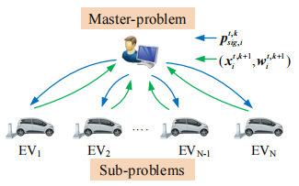
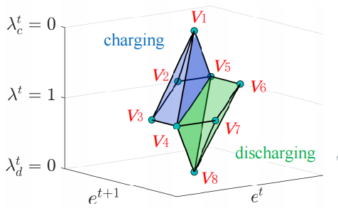
App.3 Battery Dispatch Opti. (EMS) for EV Aggregators
Vehicle EVs with bidirectional (two-way) charging capability¹
Aggregator aims to operates the large-scale battery dispatch optimization (BDO) to provide grid services
Large-scale BDO problem will be very computationally challenging since MILP-based formulation of battery operation
Distribution grids
Aggregator (EMS)
multi-story car park
EV (deploy V2G)
Least Squares Approach
Iterative decomposition-coordination framework¹
Provably computationally-efficient for BDO¹
Disjunctive optimization for battery operation²
decomposition-coordination framework
Disjunctive programming
Reference: 1. C. Lei, S. Bu, Q. Wang, Z. Ren and D. Srinivasan, “Battery Dispatch Optimization for Electric Vehicle Aggregators: A Decomposition-Coordination-based Least Squares Approach with Disjunctive Cuts ," IEEE Transactions on Power Systems, 2024
2. C. Lei, S. Bu, J. Zhong, Q. Chen and Q. Wang, "Distribution Network Reconfiguration: A Disjunctive Convex Hull Approach," IEEE Transactions on Power Systems, vol. 38, no. 6, pp. 5926-5929, Nov. 2023.

Slide 17
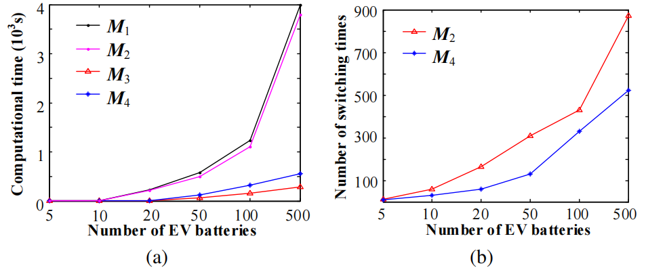
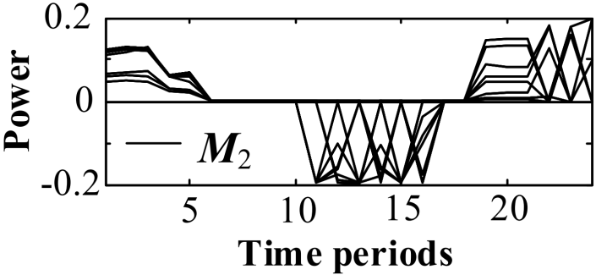
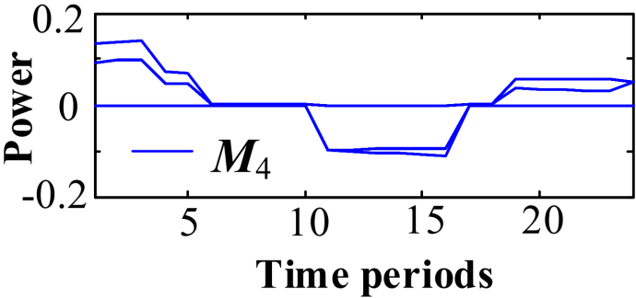
Case Study - Battery Dispatch Opti. for EV Aggregators
Decomposition-Coordination-based Least Squares (DCLS) Approach
M4 can offer exact optimal solutions with satisfactory computational performance, allowing at least 78.8% and 71.3% faster than other existing methods
DCLS
DCLS
Fig1. (a) Computational time; (b) charge-discharge switching times.
10 EV batteries are involved in a battery dispatch optimization;
Each curve represents a charging and discharging power of an EV battery;
M4: A smaller number of charging/discharging times
DCLS
(a)
(b)
Fig2. Optimal charge-discharge power solution for N=10: (a)M1; (b)M3.

Slide 18
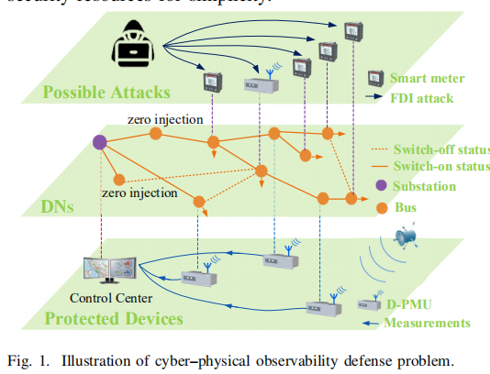
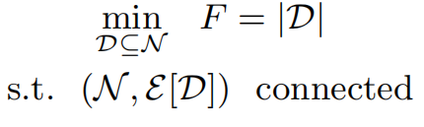
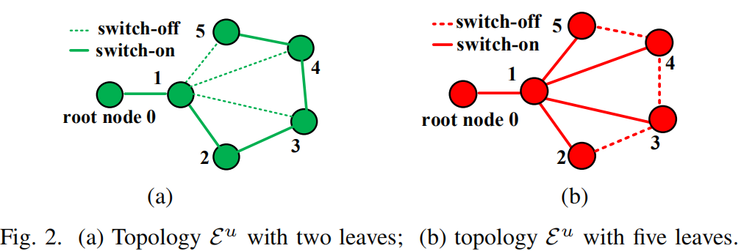
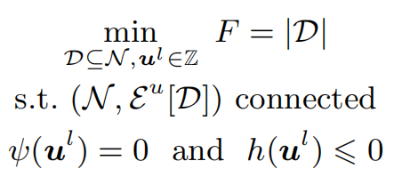
App.4 - Observability Defense-Constrained DNR
Illustration to RCDS Problem
Cyber-security concerns exist in Distribution Network Reconfiguration (DNR)
The RCDS problem is to seek a minimum node subset via evaluating a minimum cardinality , such that subgraph is connected, yielding
Disjunctive RCDS Formulation
The disjunctive RCDS problem is to seek a minimum node subset via evaluating a minimum cardinality , such that reconfigurable subgraph
is connected, yielding
Reference: C. Lei, S. Bu and Q. Wang, “Observability Defense-Constrained Distribution Network Reconfiguration for Cyber-Physical Security Enhancement," IEEE Trans. on Smart Grid, vol. 15, no. 2, pp. 2379-2382, March 2024

Slide 19
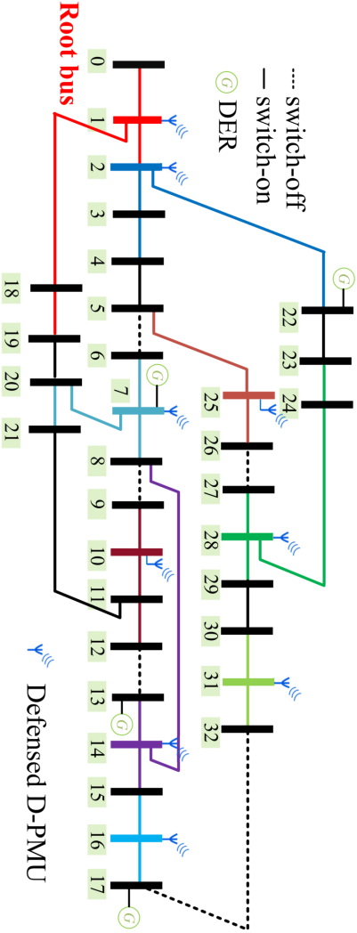
Case Study - Observability Defense-Constrained DNR
Minimum RCDS solution
(a) IEEE 33-node
DNR solution under different penetrations of D-PMUs
Table. Optimal observability defense-constrained DNR solutions
DNs | DNR Loss | Cost of Low D-PMUs |  |  |  | Cost of High D-PMUs
 |  | z^{g} | Defense | Loss | Time | z^{g} | Defense | Loss | Time
16-node | 0.030 | 5 | 6 | 0.0323 | 0.521 | 5 | 5 | 0.0318 | 0.500
33-node | 0.054 | 9 | 11 | 0.0594 | 2.368 | 9 | 9 | 0.0586 | 1.719
123-node | 0.099 | 35 | 41 | 0.1029 | 175.542 | 35 | 35 | 0.0995 | 151.024
1060-node | 0.140 | 45 | 59 | 0.1823 | 225.032 | 45 | 45 | 0.1409 | 179.078
(b) IEEE 123-node
This proposed DNR can seek the minimal loss, whilst enhancing cyber-physical observability with minimal defense cost.

Slide 20
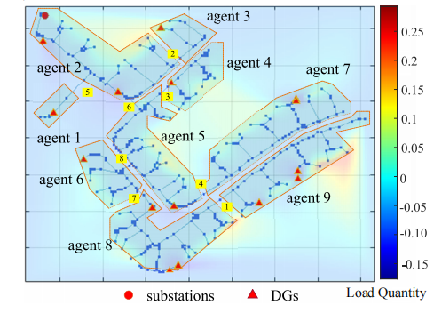
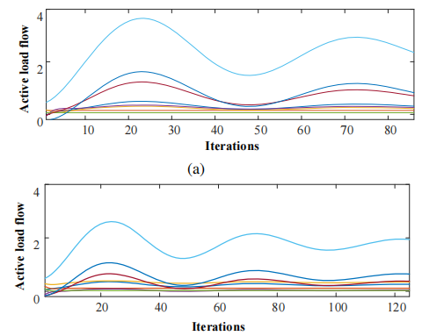
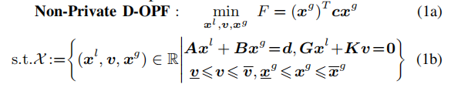
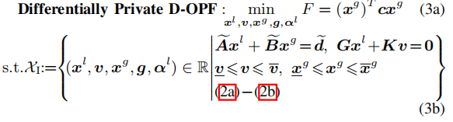
App.5 - Differentially Private ADMM for OPF
Privacy-related Complications in Multi-Agent Distribution Networks
The centralized operation architectures will gradually transit to decentralized and distributed coordination architectures between multiple agents.
Agents may be stakeholders with conflicting interests, e.g., retailer/user, and thus their exchanged information of tie-line’s load flows across adjacent agents may still meet privacy-related complications.
Differentially Private ADMM for Decentralized OPF
This differentially private OPF model can output a mixture of obfuscated-but-feasible load flow solution for the tie-lines across adjacent agents and realistic generator output solution
Reference: C. Lei, S. Bu, Q. Chen, Q. Wang and D. Srinivasan, “Decentralized Optimal Power Flow for Multi-Agent Active Distribution Networks: A Differentially Private Consensus ADMM Algorithm," IEEE Trans. on Smart Grid, 2024 (Early Access)

Slide 21
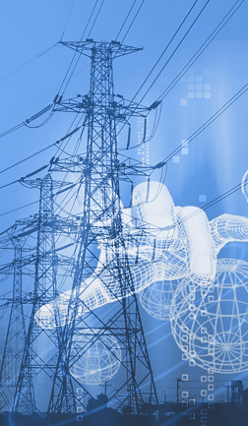



Follow-up Research Plan
Power System Optimization and Asset Management
Battery Simulation Modeling with Electrochemical Modules
Data-driven Battery Aging Quantification
Power Utility Asset Management with a focus on Battery
Operational Flexibility Enhancement of Power Systems Penetrated with EVs

Slide 22


Host Intro
Knut and Alice Wallenberg Fellow (WAF)
Lina Bertling Tjernberg (Docent, Ph.D., MSc.) is a Professor in Power Grid Technology at KTH – The Royal Institute of Technology, Stockholm, Sweden. She is Deputy Head of the School of Electrical Engineering and Computer Science (EECS) with a focus on research conditions and impact. She is a Fellow of IVA the Royal Swedish Academy of Engineering and Fellow of IEEE.
Marie Sklodowska-Curie Actions (MSCA)
Bikash Pal, FIEEE, FREng , is Professor of Power Systems at Imperial College London. He is research active in power system stability, control and computation. His research is sponsored by EPSRC, National Grid, GE, ABB,SIEMENS, UK Power Networks. He was Editor-in-Chief of IEEE Transactions on Sustainable Energy. He is Series Editor of Elesevier series on Sustainable Energies and Fellow of IEEE for his contribution to power system stability and control. He is Fellow of The Royal Academy of Engineering, UK for the industrial impact of his research in power network control.

